Slide 1

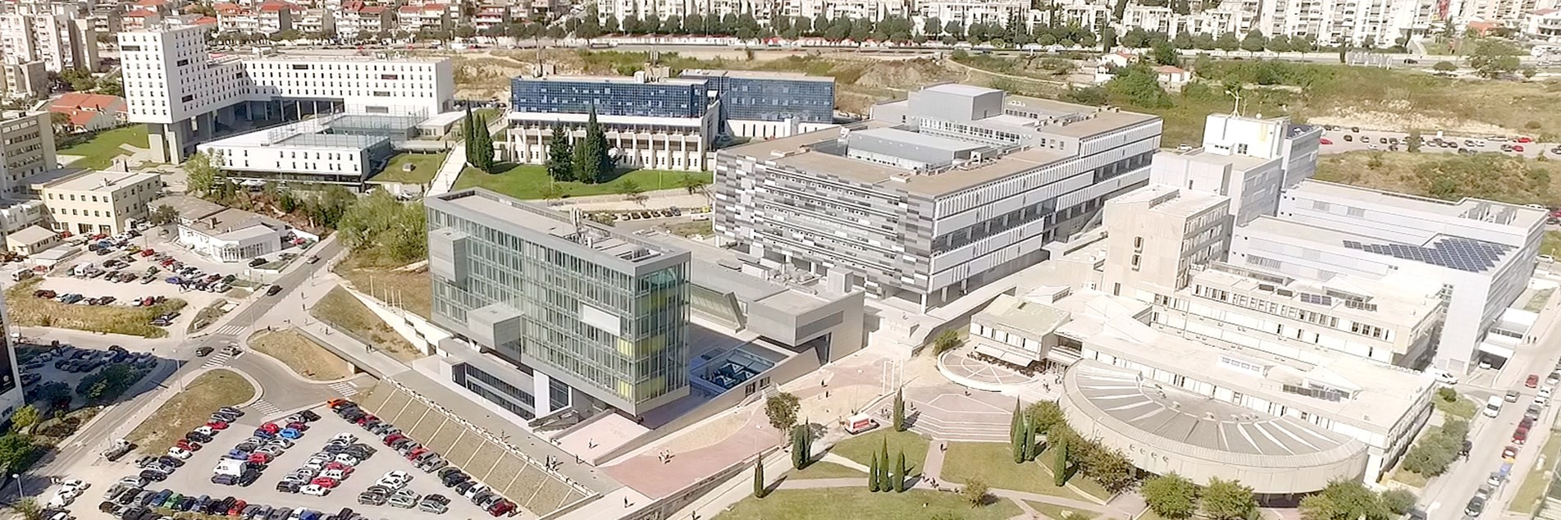
TEACHING PUBLIC HEALTH INSTITUTE OF SPLIT AND DALMATIA COUNTY
How to Protect Yourself and Others
COVID-19

Slide 2
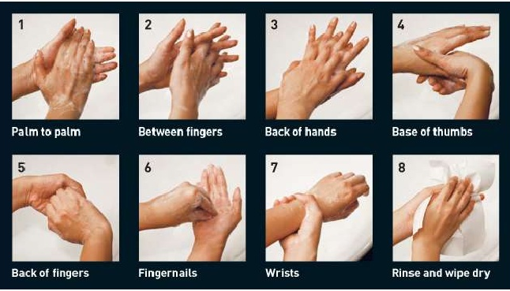
WASH YOUR HANDS
with soap and water for at least 20 seconds
If there’s no visible dirt on your hands,
disinfect frequently

Slide 3
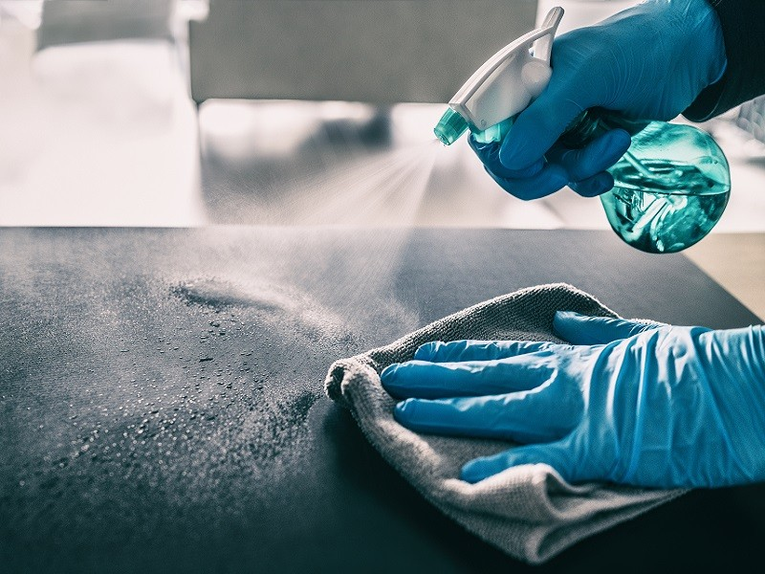
DISINFECTION
Clean and disinfect frequently touched surfaces daily

Slide 4
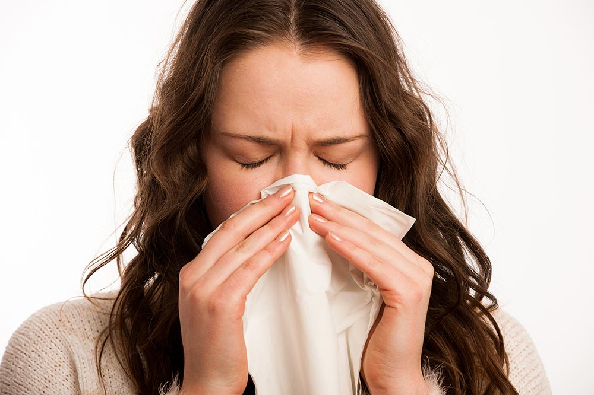
Always cover your mouth and nose with a tissue when you cough or sneeze, throw used tissues in the trash, wash your hands

Slide 5

AVOID TOUCHING YOUR EYES, NOSE, AND MOUTH WITH UNWASHED HANDS

Slide 6
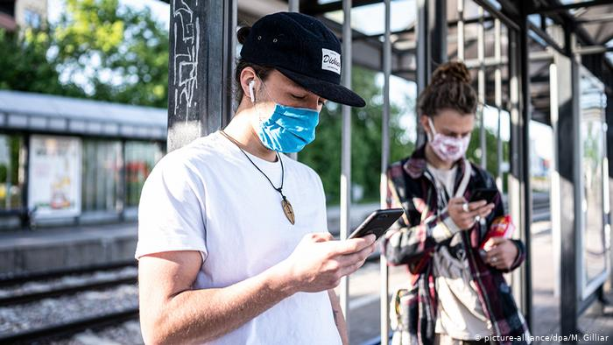
COVER YOUR MOUTH AND NOSE WITH A MASK

Slide 7
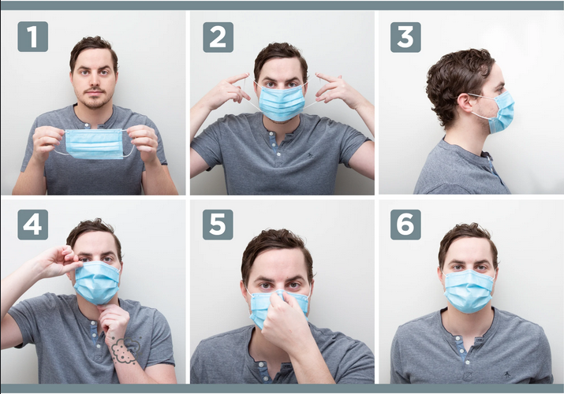
PROPER STEPS TO WEARING MASK

Slide 8
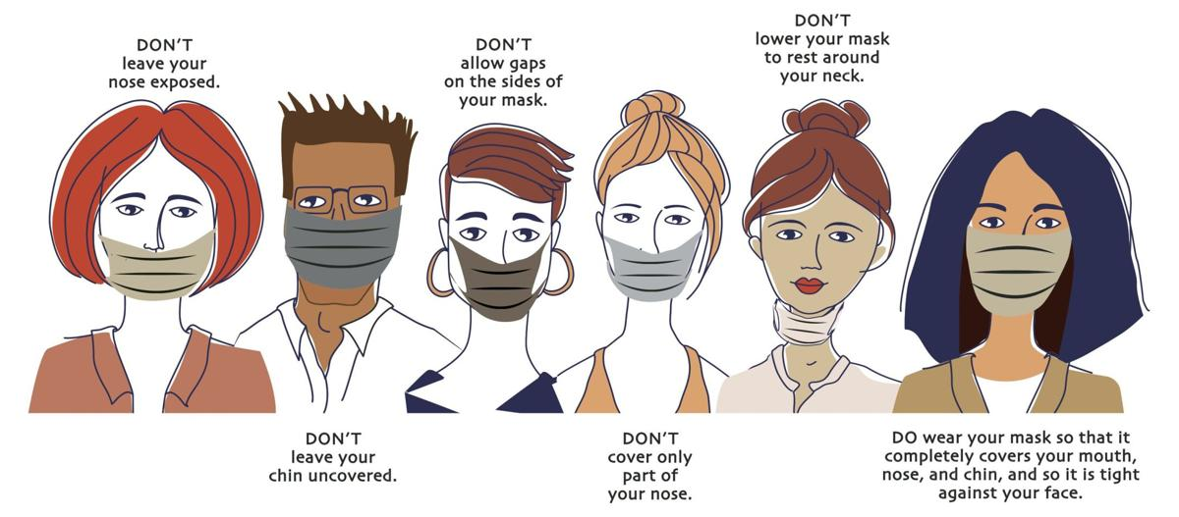

Slide 9
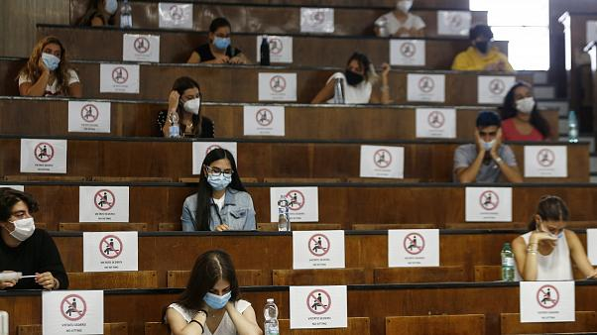
WATCH YOUR DISTANCE

Slide 10

AVOID CROWDING

Slide 11

-COUGH
-FEVER
-SHORTNESS OF BREATH/DIFFICULTY BREATHING
-NEW LOSS OF TASTE OR SMELL
-HEADACHE
-SORE THROAT
-CONGESTION OR RUNNY NOSE
-DIARRHEA
-FATIGUE
-MUSCLE AND JOINT PAIN
-...
Stay home except to get urgent medical care

